Slide 1
FIRST YEAR WELCOME
With [INSERT PRESENTER NAME AND JOB ROLE HERE]
Notes:
Welcome and introduction – I’m….name, job role.
Welcome to the start of your Optometry degree here at [university name] – congratulations on getting to this point – it’s a huge achievement already.
I’m here today to introduce you to the support available to you during your studies and then throughout your career from the Association of Optometrists, or AOP
As an optometrist, you’ll play an essential role in safeguarding the nation’s eye health.
As the AOP, we play an essential role in safeguarding you.
I’m going to give you a short presentation about how the AOP can help you get the most out of your time at university, as well as beyond.

Slide 2
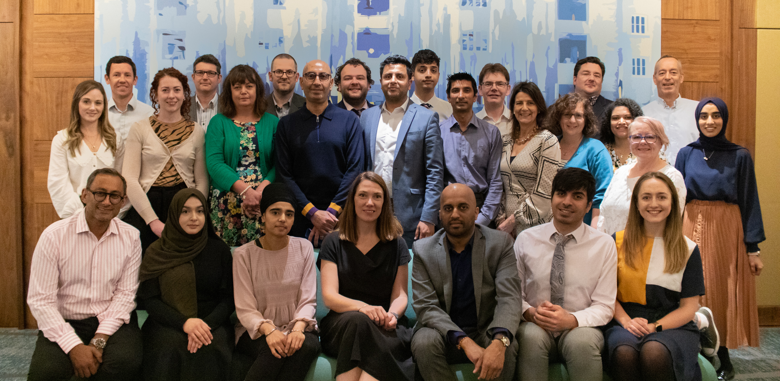
Hello from the AOP!
Notes:
So a quick hello from some of the others at the AOP.
These are all our Councillors who represent our members, they are all either studying or practicing optometrists, Laura represents Undergraduate students, (you might have spotted her on our Instagram). Indy represents our preregistration students…

Slide 3
For over 75 years we have been the lead membership association for the optical profession
We serve, protect and promote the interests of our members and, through them, the UK’s eye health
We support you with a range of valued services and benefits
What does the AOP do?
Notes:
Show of hands – has anyone heard of the AOP? Take any contributions…
Over 17,000 members – from students through to retired optoms
Provide a community of like-minded professionals
Support – through a range of membership benefits – we’ll come on to
Protect – via legal and employment support, including legal defence and we can arrange union representation (but we’re not a union)
Represent – by giving the profession a voice, promoting the importance of optometry to government linked healthcare professions, the media and the public.

Slide 4
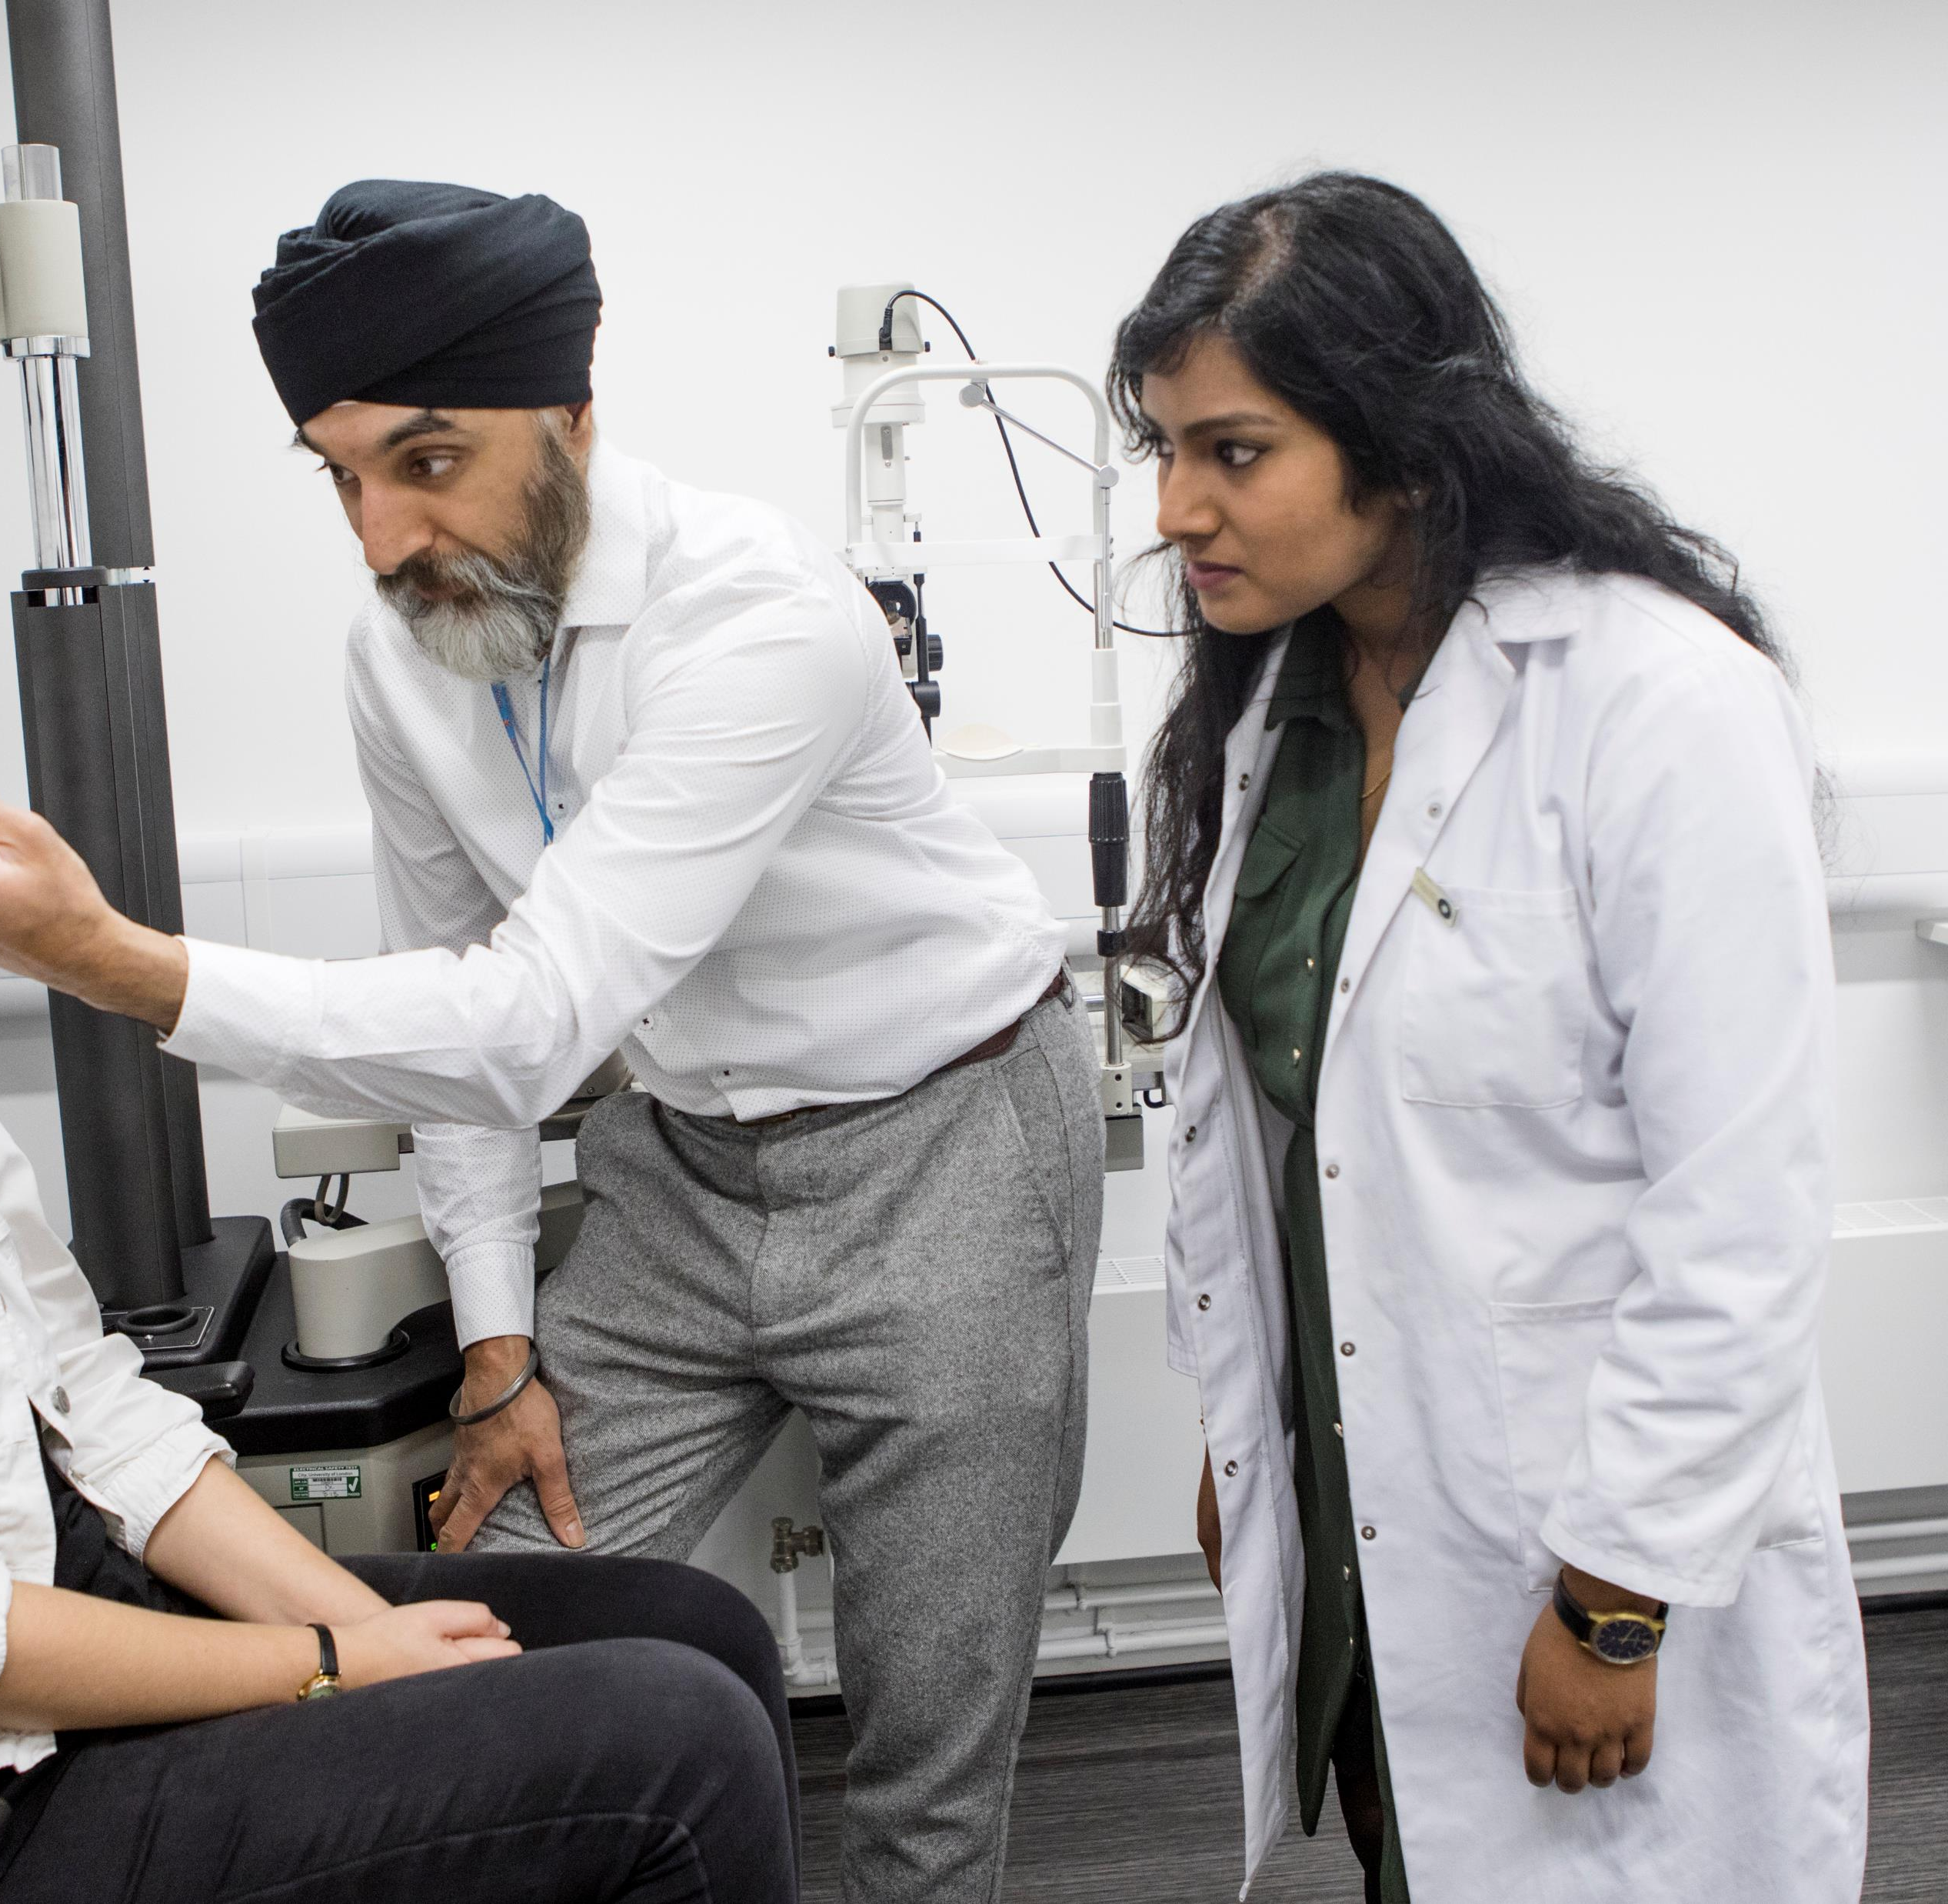
Your journey…
At university for four years with scheduled clinical placements
Then qualifying assessments
Once qualified, you are required to have medical malpractice insurance
Notes:
You’ve all just started on your journey to qualification. Ask students to each introduce themselves to the person next to them and discuss what you’re most looking forward to during your studies, and what you’re least looking forward to.
ASK FOR VOLUNTEERS TO SHARE ANSWERS
Take through slide… add an interesting fact about each stage (preferably areas that will later relate to our support)
Anyone know what OSCE stands for? (Objective Structured Clinical Examination)
What does medical malpractice insurance protect you against? Legal costs or compensation of any clinical negligence claims
Add on some general population facts at the end, highlighting the impact their qualified status could have…
- over two million people living in the UK with severe sight loss, and over half of those could have been prevented if they’d had a sight test sooner.
- Direct link between sight loss and wellbeing – such as depression
- 2/3 of registered blind and partially sighted people of working age are not in paid employment
- Sight tests can detect more than bad eyesight – diabetes, high blood pressure, even tumours.

Slide 5
Other optical bodies
Must register to study and practice optometry
Regulatory body
First interest is protecting the public
Investigates fitness to practice
Set up for the public benefit
Run the current pre-registration scheme for the GOC and facilitate the new ETR scheme with a selection of universities
Look after the guidelines and ethics of the profession
Notes:
There are some other professional bodies that you need to be aware of.
Have the General Optical Council or College been in to see you yet?
GOC
MUST Register on an annual basis to be able to study and practice
They protect the public by setting standards of practice and professional conduct
GOC investigations and subsequent proceedings can be incredibly lengthy – cases have taken up to two years
They are an authority figure you need to stay on the right side of
College
Charity
They are more of a teacher/examiner type figure
University
And of course you have your university to support and guide you – for now ☺

Slide 6
We protect, support and represent you
Optometry Today (OT) journal
Online education library
Online career guidance and mentoring
Health and wellbeing resources
Your voice represented
Legal, regulatory and employment law expertise
Notes:
While GOC and College are more authority figures, our purpose and the reason we exist, is to protect, support and represent your best interests while you’re on your journey to qualification and throughout your career.
These are some of the ways we do this.
Optometry Today - our bi-monthly journal [you’ll get your free copy today], which has regular student features and content, as well as industry news, research and career guidance. Our members get 6 copies a year sent to your preferred address, and full access online, which includes our online education library (more on this later)
Our online career guidance includes web content, webinars and features in OT, and we also have a mentoring programme for pre-registration and newly-qualified optometrists. There is also a student specific section which houses some great stuff such as a University Survival Guide, made by optometry students and lecturers.
Our wellbeing resources include webinars, stress management tips, and our Peer Support line is open to anyone in optics, including students, it’s free and completely confidential to call. Our volunteers all work in the optical sector, and are trained to listen and help you work through what ever is worrying you. I’ll share the number later.
Our Council, and student reps, listen and ask for your views so we can make sure you are part of the optometry community, and the student voice is represented in our work and services (student survey and student reps).
Perhaps most importantly, we can support and advise our members with legal, regulatory or employment issues that may affect your career, now or in the future – and I’ll go into those a bit more shortly.
Ultimately, we have lots of other benefits designed to support students and newly-qualified optometrists because
we want to help you to make the best out of your career at every step. We want you to call on our expertise so we can support you to succeed in a career supporting your patients.
However… the benefits I’ve mentioned are only accessible to members, and many will require a membership number or login to access.

Slide 7
All completely free
until you qualify!
Notes:
The good news is, you can become a member today – and it’s completely free until you qualify! We also offer a reduced rate when you become a newly-qualified optom.
As part of our visit here today, I’ll be providing you with an exclusive sign-up link at the end, as well as offering some freebies as a welcome gift.

Slide 8
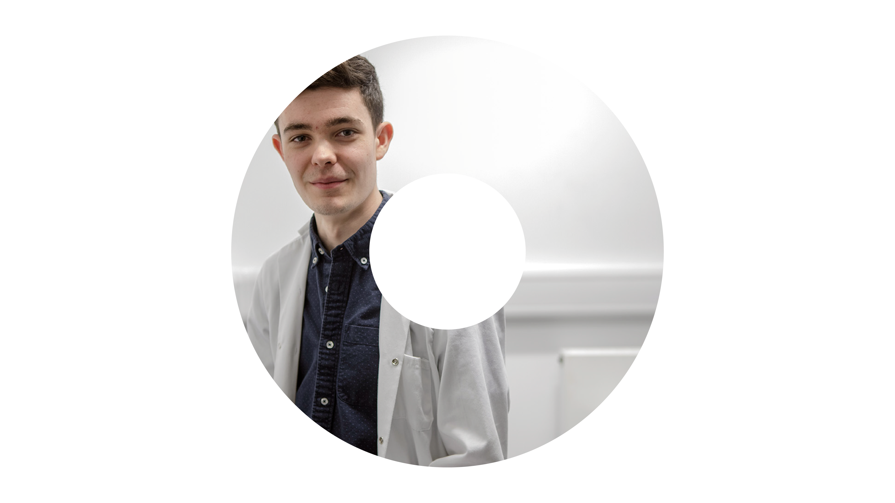
Protecting you
Expert legal and regulatory advice and support
Employment advice when you’re considering your pre-registration or in practice clinical placement
24-hour non-optometry legal helpline
Notes:
But before that, here’s some more information about the legal, regulatory and employment support we offer our members.
We have a team of in-house lawyers and optometrists who are experts in in optical regulation, clinical negligence, professional discipline and employment law, and you can contact them for advice and support if you ever encounter a situation that could jeopardize your career, whether that’s at uni, with the GOC or with an employer. They also produce online guidance for members which you can access
When you’re considering your pre-registration placement next year, if you have any questions or concerns about your new employment contract, you can ask the employment law team to check it over, so you fully understand what it covers, and understand your obligations and rights, especially around tie-in fees and the kind of supervision you’ll get. They can also help with any queries or issues you have during your pre-reg placement or once you qualify
You can also call our non-optometry legal advice line, which can assist you with things like neighbour disputes, landlord and tenant issues, criminal enquiries and a lot more.

Slide 9
Notes:
Here’s some more information from our Legal Director, who can explain a bit more about how we support and protect students like you.

Slide 10
Representing you
AOP student representatives
Student Councillors
We ask your views on the issues that matter
We influence the sector and shape its future
Notes:
Laura and Indy are your undergraduate and pre-registration Councillors and their role is to liaise with reps, other Councillors and AOP members to ensure your voice is heard.
IF NO STUDENT REP IN THE ROOM
You’ll meet our new student reps on Instagram over the next couple of weeks, so make sure you follow us there and there might just be a student giveaway too…
IF STUDENT REP IN THE ROOM
You also have a student representative here at {university name} who will be working to represent your views and feedback to the AOP. I’ll let them introduce themselves now and tell you a bit more about themselves… HAND OVER
There is a lot of change on the horizon for optometrists in the UK, and the AOP will be working hard to represent our members to influence the direction of change in the best interests of our members.
We are planning to get in touch with you and all student optometrists later this year, to ask your views on some important issues. It will be a really great opportunity for you to get involved and make sure your experiences and views are heard, the more student members who participate the louder our voice.

Slide 11
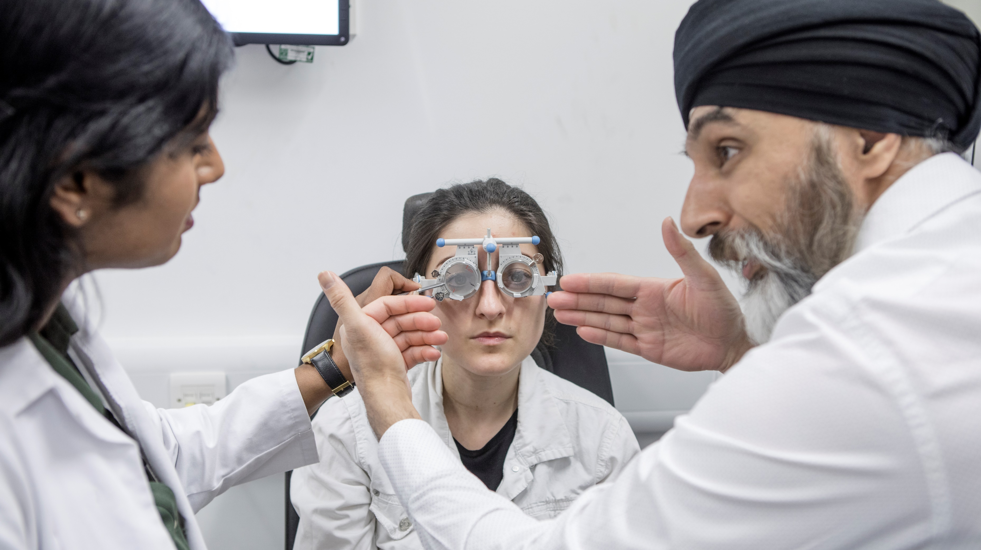
Your journey to qualification
Notes:
Before we finish, I’m just going to touch on what we offer students a bit further along their journey….

Slide 12
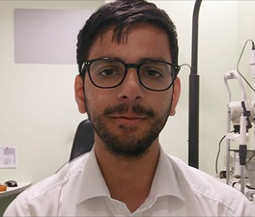
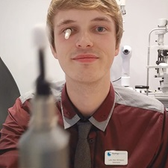
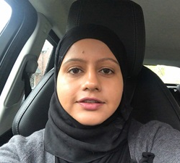
Your clinical placement
Where your career can take you vlogs
National pre-registration placement and vacancy list
Employment law advice and contract checking service
Qualifying assessment preparation advice and guidance
Notes:
While this might feel a long way off now, you will need to be prepared and think about what you want for your placement
A good place to start might be to do some research and our ‘Where your career can take you vlogs…’ which have 10 optometrists in a variety of career settings – everything from highstreet multiple or independent, hospital, domiciliary and charity - explaining what they love about their jobs – you can see three of them here
When you’re ready, you can use our online listings to see if there is a placement near you,or advertise your availability on our register.
Contracts can be tricky to understand with tie-in fees and the amount of supervision you can expect being key areas to examine closely. Get in touch with our employment team if you have any questions or concerns about your pre-registration employment contract, especially if you don’t understand what supervision will be available to you, or if you’re not sure how long you’re tied into fees repayment
We’ll also email you and post tips and guidance on our social media to help you prepare for your OSCE, and OT runs regular features with pre-reg students

Slide 13
Newly-qualified and beyond…
Medical malpractice insurance
CPD online and at events
Flexible membership to suit your career
Legal, clinical and employment support
Representation on the issues that matter to you
Notes:
Once you’re qualified, it’s a requirement to have insurance, and that comes as standard with many of our qualified membership packages, as well as all the other benefits we’ve covered today and more.
You’ll also need to meet the GOC’s requirements for continuing professional development, and we’ve got that covered too with OT’s online CPD, webinars and face to face events including 100% Optical which is the UK’s largest trade show
We have a range of membership grades to offer you flexibility including concessionary grades for those working part time, and a payment freeze for those taking parental leave (where or a career break, and those wanting to work overseas
All the support and representation we’ve talked about today continues throughout your career, whatever path you choose to take.

Slide 14
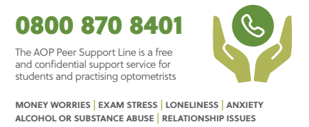
Supporting you
Optometry Today
Online education Library
Peer Support Line and wellbeing resources
Career guidance and mentoring
Notes:
So, to recap what’s on offer to you…
Optometry Today, is the AOP’s journal - delivered to you bi-monthly. It covers all the latest news, research, science, career
Online education library - study resource with over 30 video skills guides, and hundreds of past CPD exams to practise your core skills
Wellbeing resources -Peer Support Line for anyone in optics who might be experiencing stress, anxiety or you’re just feeling a bit overwhelmed by uni life. It’s a free and confidential space to talk through your troubles and find some clarity.
We also have a bank of wellbeing webinars and stress management tips on our website.
Career guidance - career features and online resources via OT, an AOP mentoring programme that matches you with a qualified and experienced optometrist who can help you identify career goals and develop your confidence and the university survival guide.
Student representative – to help collect your feedback and shape the future of your profession.
Legal, regulatory and employment support – as outlined in the video by Ella.

Slide 15
Free until you qualify
Immediate access to all benefits
Must be renewed annually
Contact preferences easily changed to suit
Similar to any subscription or membership, only members get access to the good stuff!
www.aop.org.uk/studentjoining2023
Notes:
This is all completely free, and if you use the link on the screen you’ll get your membership number straight away and have immediate access to everything I’ve just mentioned.
I also have some welcome gifts to offer to those who join today – you can choose a wireless phone charger or torch pen, plus your first free copy of OT.
As an additional thank you for taking the time to listen to us and join today, everyone who joins using this link today will be entered into a prize draw for this cohort only, where you’ll have a chance to win …………………
I’ll give you a few minutes to use the sign-up link now. Just show me your confirmation screen on your way out and you can choose your welcome gift.
[Wait for registrations to be completed, and answer any questions)

Slide 16
@association_of_optometrists
0207 549 2000 (switchboard)
0800 870 8401 (Peer Support)
ritadavids@aop.org.uk
wendysteele@aop.org.uk
Notes:
Finally, do feel free to follow and keep in touch with us, using the options on screen.
Our Instagram is @association_of_optometrists (you can also find OT’s Instagram via the link in our bio)
Ans if you did have any concerns about the legal declarations, please feel free to contact Wendy Steele on the email above.

Slide 17
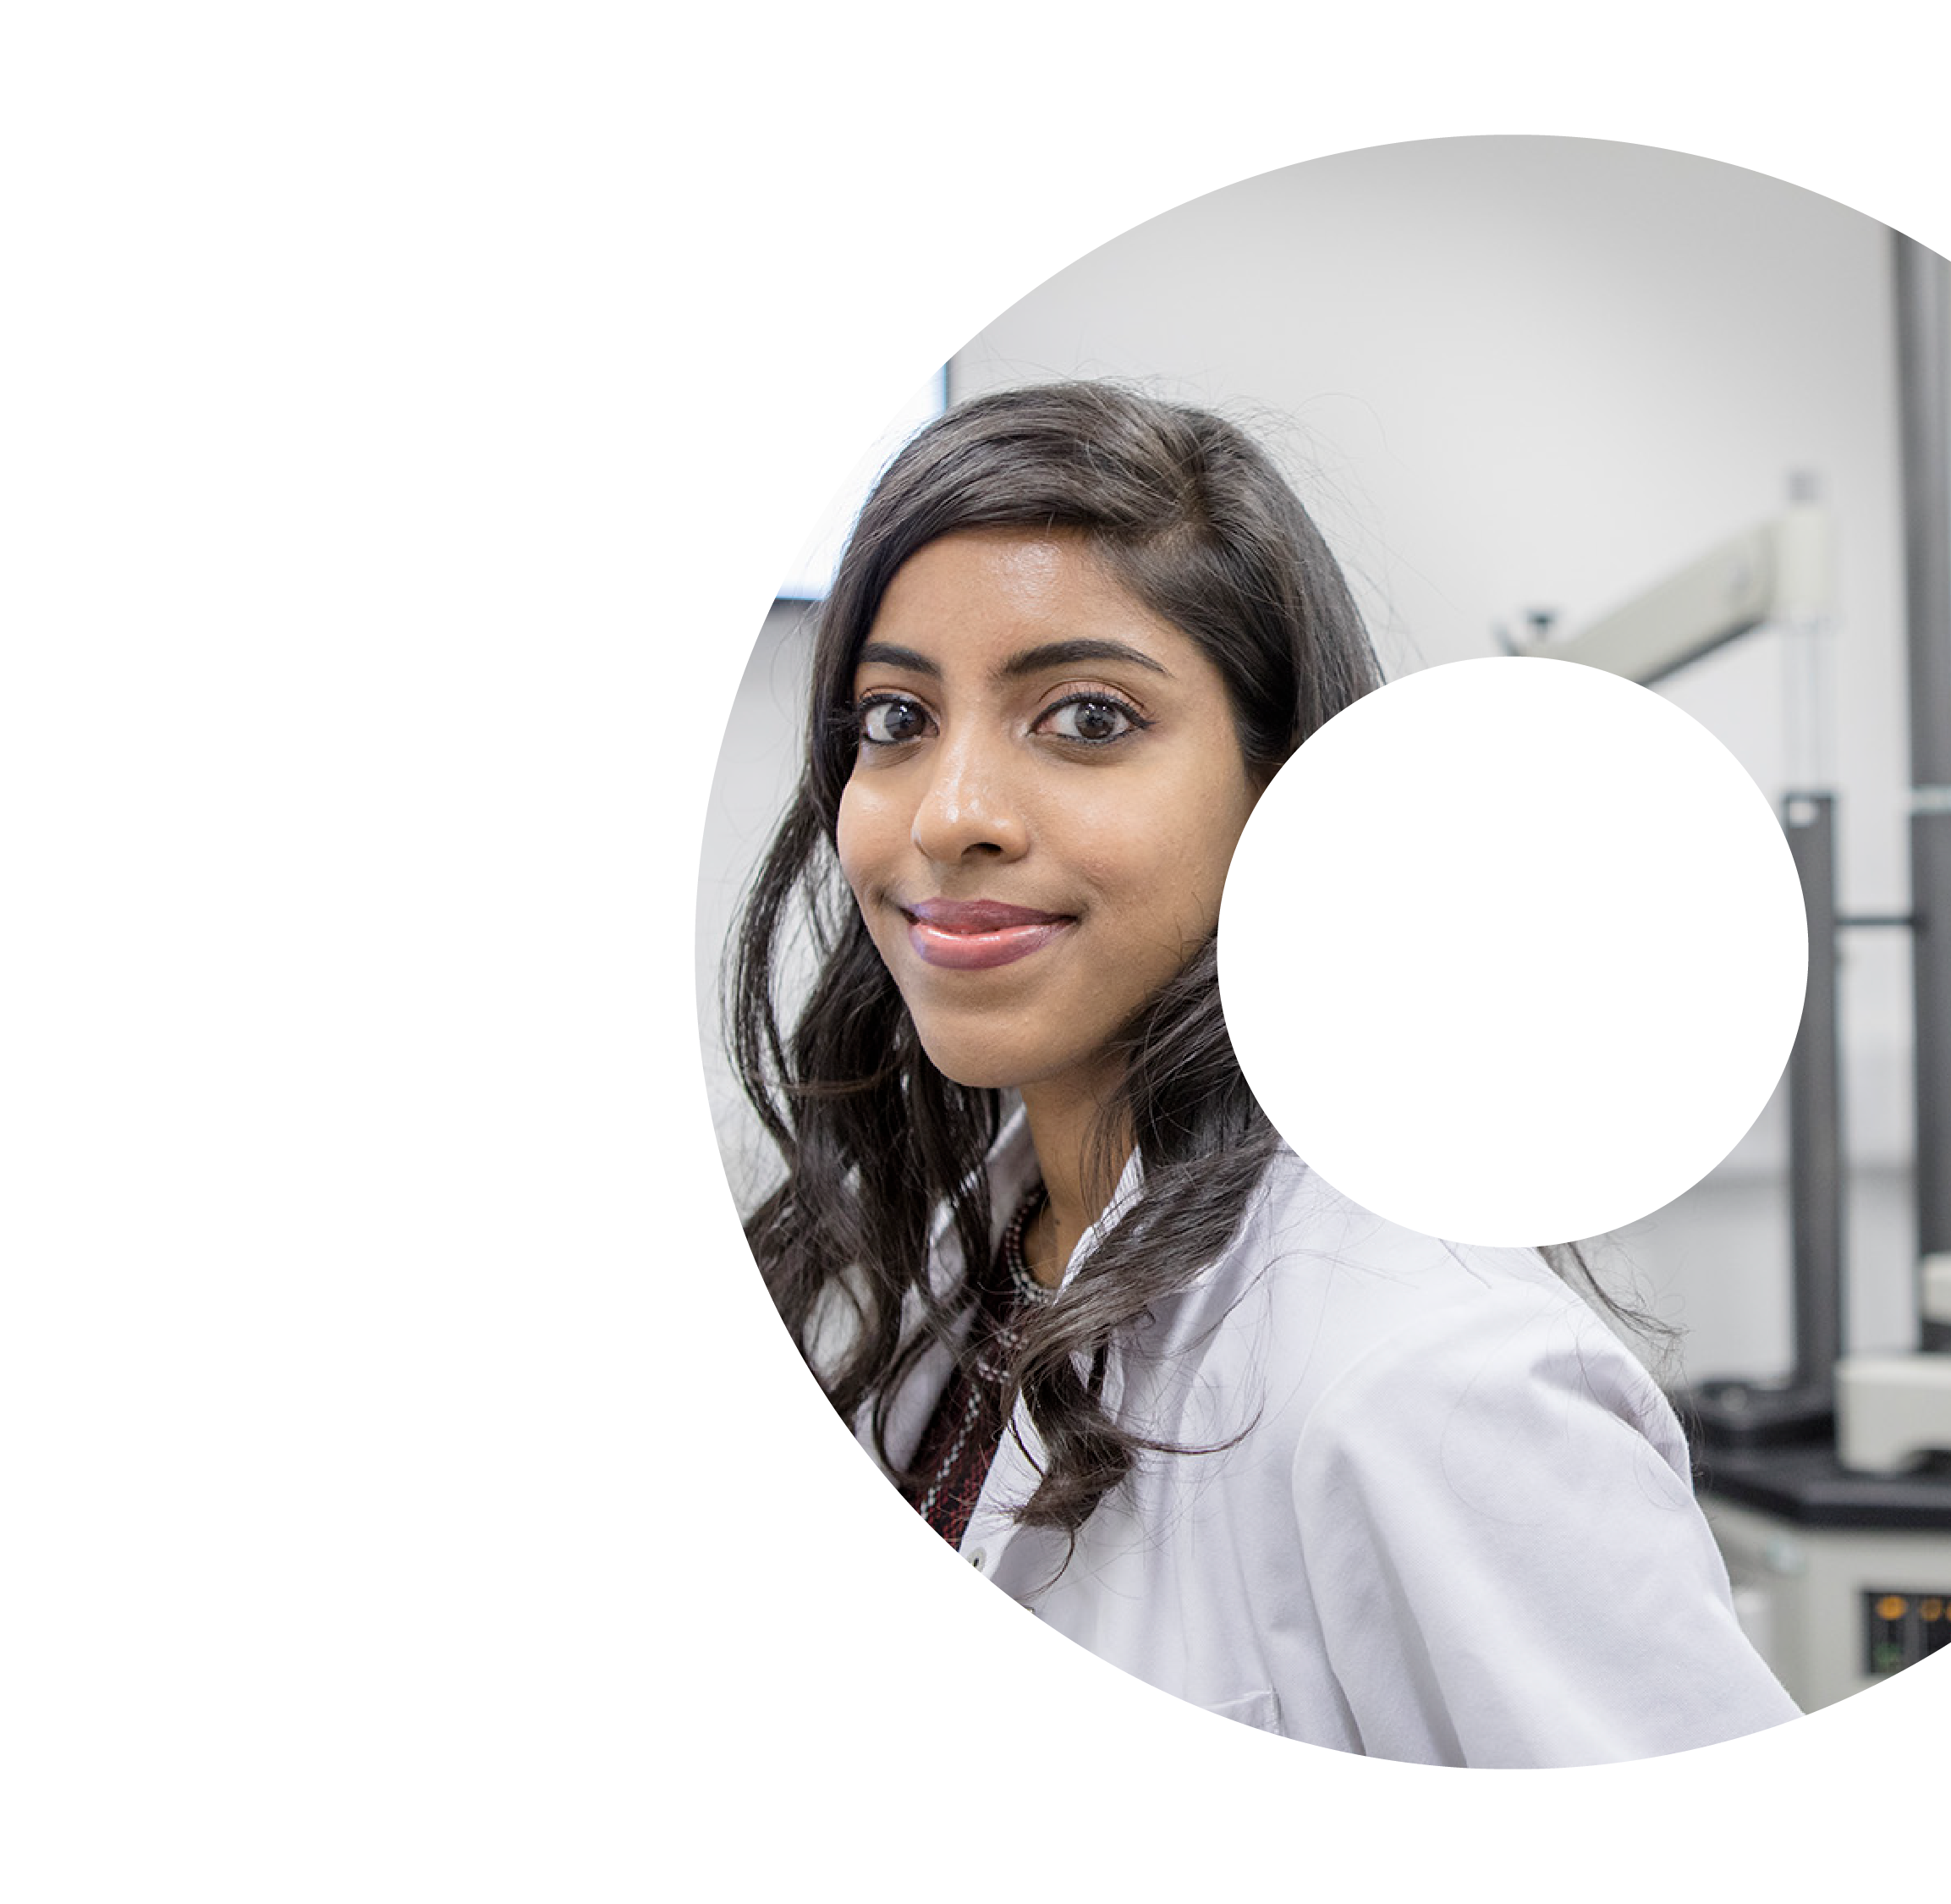
Questions?

